Slide 1
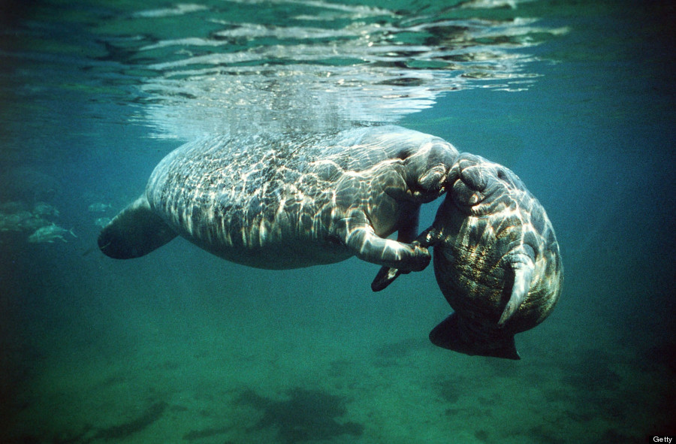
Examining the relationship between manatee physiology and environment and manatee death by watercraft collision.
Steven Layne
Manatee Enthusiast

Slide 2
Dataset Description
Size (cm)
Waterways(Low Counts)
Counties -----
Cities -----
Sex(M,F,U) → Sex(M,F)
Date → Seasons
| Regions(NW,NE,SW,SE)

Slide 3
Null Hypothesis
H0: The occurrence of collisions in manatees does not differ with size, sex, region or season.
Notes:
The occurrence of collisions in manatees does not differ with combinations of the size, sex, region or season where they may be independent of one another or interact.

Slide 4
GLM Based Analyses
4 Explanatory Variables
Sex: Categorical
Region: Categorical
Season: Categorical
Size(cm): Continuous
Bionomial Response
Collision: True/False

Slide 5
Choosing Model(StepAIC)
glm(formula = Collision ~ Sizecm + Region + Sex + Season + Sizecm:Sex +
Region:Sex + Sizecm:Season + Region:Season + Sex:Season +
Sizecm:Sex:Season, family = binomial, data = mortD, na.action = na.fail)
Sex:Season Interaction Removed

Slide 6
Choosing Model(MumIN)
.....
.....
.....
.....
.....
.....
.....
.....

Slide 7
Selected Model
Region
Season
Sex
Size (cm)
Region interaction with Season
Region interaction with Sex
Season interaction with sex
Sex interaction with size (cm)

Slide 8
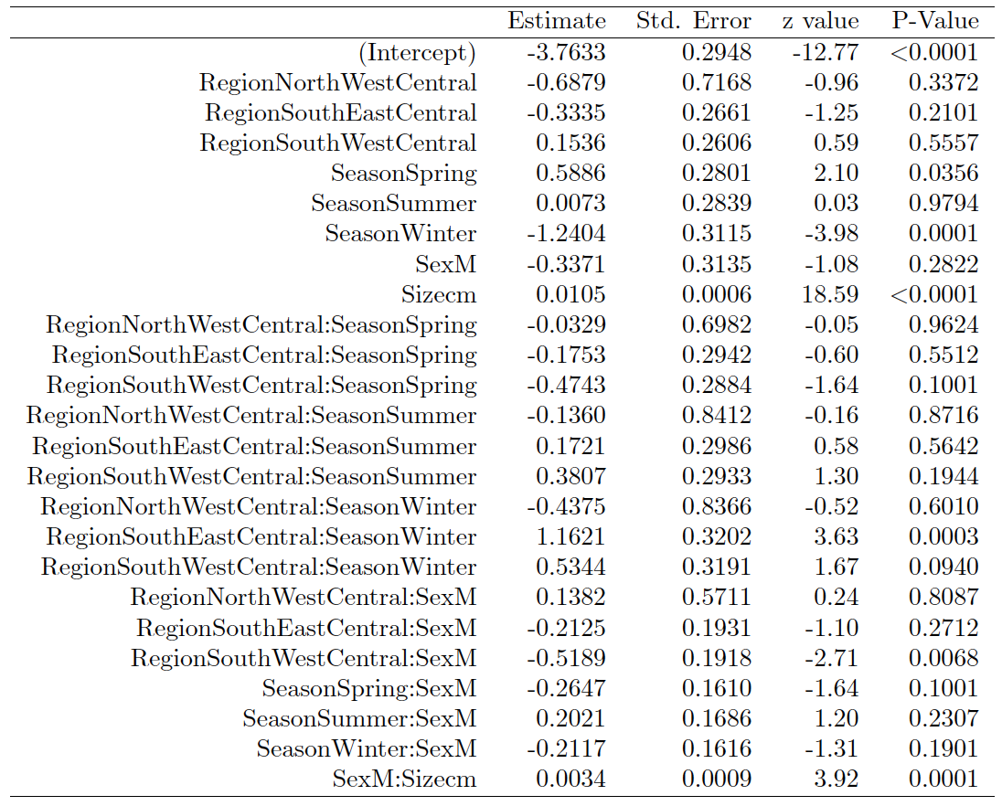

Slide 9
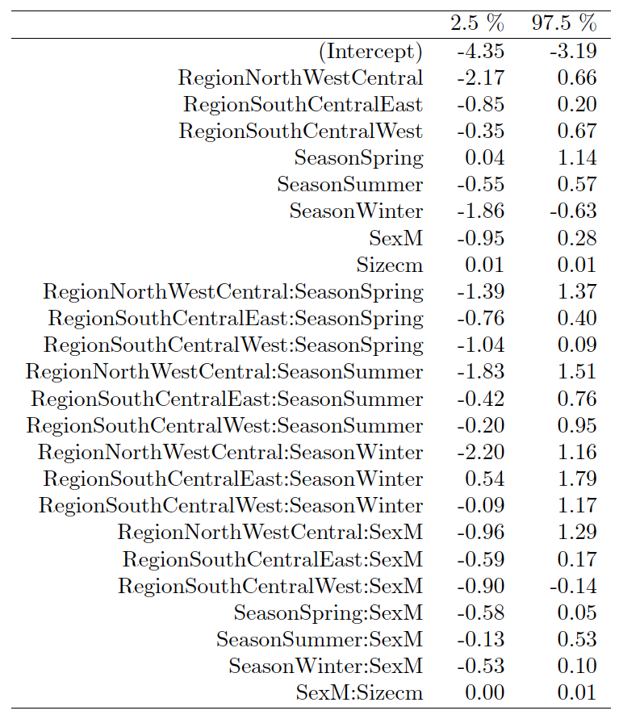
Confidence Interval for Parameters

Slide 10
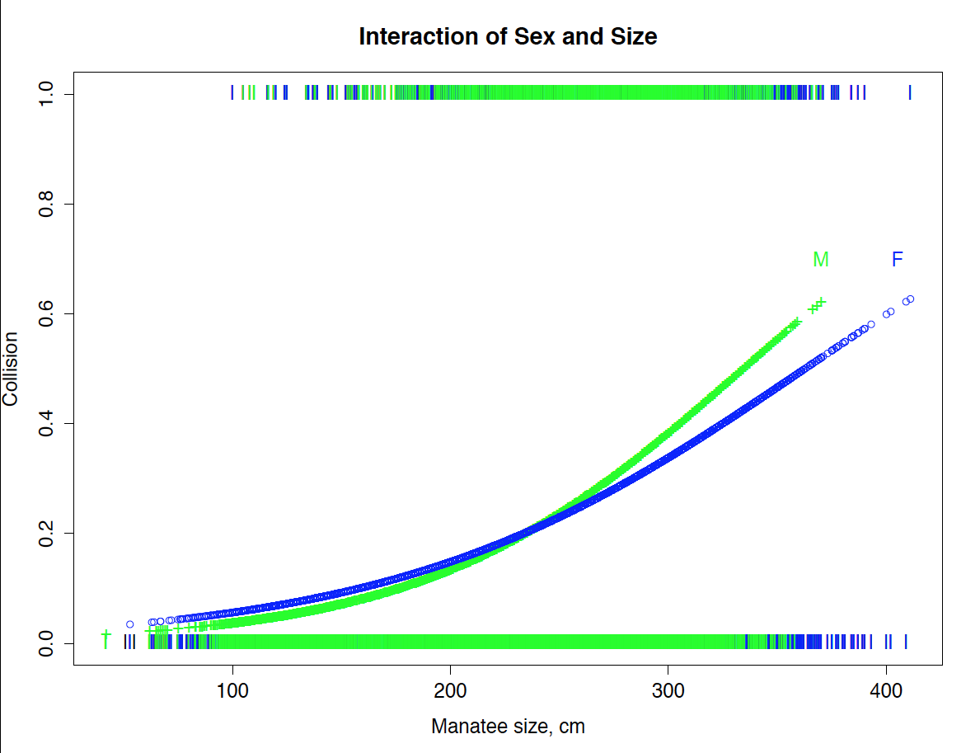
Interactions

Slide 11
Two Populations
Collisions
Non- Collisions

Slide 12
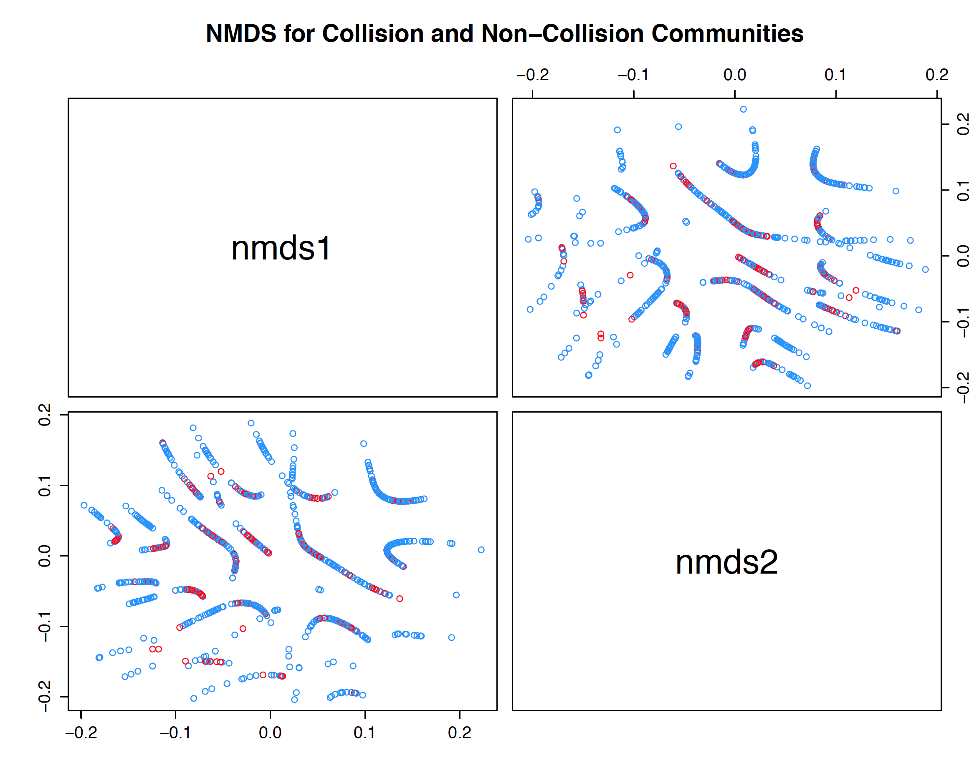
NDMS

Slide 14
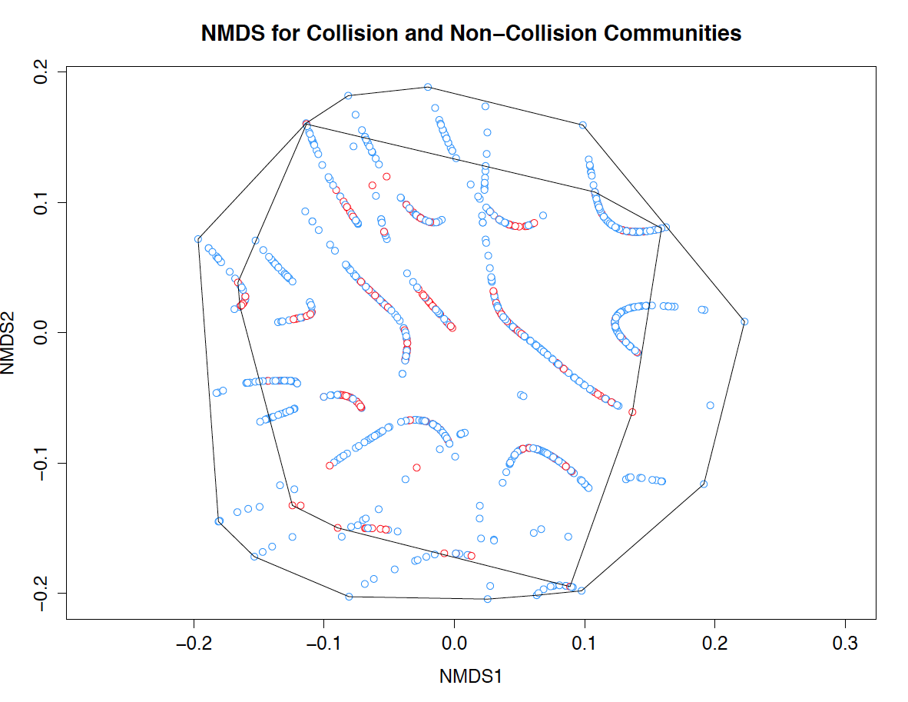

Slide 15
Future Studies
Interested in the distribution of death and how it varies by region.

Slide 16
Future Studies(Frequency Distributions)
NorthEast Central |  | Probable.Cause | Counts | Proportions
 |  | Human Related: Flood Gate/Canal Lock | 11 | 0.01
 |  | Human Related: Other | 15 | 0.02
 |  | Human Related: Watercraft Collision | 242 | 0.27
 |  | Natural: Cold Stress | 142 | 0.16
 |  | Natural: Other | 47 | 0.05
 |  | Perinatal (<= 150 cm) | 157 | 0.17
 |  | Undetermined: Other | 66 | 0.07
 |  | Undetermined: Too Decomposed | 211 | 0.23
 |  | Verified: Not Recovered | 7 | 0.01
 |  | Total: | 898
SouthEast Central |  | Probable.Cause | Counts | Proportions
 |  | Human Related: Flood Gate/Canal Lock: | 154 | 0.03
 |  | Human Related: Other | 119 | 0.03
 |  | Human Related: Watercraft Collision | 897 | 0.20
 |  | Natural: Cold Stress | 492 | 0.11
 |  | Natural: Other | 324 | 0.07
 |  | Perinatal (<= 150 cm) | 1078 | 0.24
 |  | Undetermined: Other | 417 | 0.09
 |  | Undetermined: Too Decomposed | 910 | 0.20
 |  | Verified: Not Recovered | 104 | 0.02
 |  | Total: | 4495
NorthWest Central |  | Probable.Cause | Counts | Proportions
 |  | Human Related: Flood Gate/Canal Lock | 2 | 0.01
 |  | Human Related: Other | 3 | 0.02
 |  | Human Related: Watercraft Collision | 24 | 0.13
 |  | Natural: Cold Stress | 33 | 0.17
 |  | Natural: Other | 12 | 0.06
 |  | Perinatal (<= 150 cm) | 58 | 0.31
 |  | Undetermined: Other | 6 | 0.03
 |  | Undetermined: Too Decomposed | 33 | 0.17
 |  | Verified: Not Recovered | 18 | 0.10
 |  | Total: | 189
SouthWest Central |  | Probable.Cause | Counts | Proportions
 |  | Human Related: Flood Gate/Canal Lock | 56 | 0.01
 |  | Human Related: Other | 67 | 0.02
 |  | Human Related: Watercraft Collision | 984 | 0.23
 |  | Natural: Cold Stress | 307 | 0.07
 |  | Natural: Other | 958 | 0.22
 |  | Perinatal (<= 150 cm) | 761 | 0.18
 |  | Undetermined: Other | 231 | 0.05
 |  | Undetermined: Too Decomposed | 805 | 0.19
 |  | Verified: Not Recovered | 132 | 0.03
 |  | Total: | 4301

Slide 17
Citations
David B. Dahl (2016). xtable: Export Tables to LaTeX or HTML. R package version 1.8-2. https://CRAN.R-project.org/package=xtable
Jari Oksanen, F. Guillaume Blanchet, Roeland Kindt, Pierre Legendre, Peter R. Minchin, R. B. O'Hara, Gavin L. Simpson, Peter Solymos, M. Henry H. Stevens and Helene Wagner (2016). vegan: Community Ecology Package. R package version 2.3-4. https://CRAN.R-project.org/package=vegan
*Kamil Barton (2016). MuMIn: Multi-Model Inference. R package version 1.15.6. https://CRAN.R-project.org/package=MuMIn
R Core Team (2015). R: A language and environment for statistical computing. R Foundation for Statistical Computing, Vienna, Austria. URL https://www.R-project.org/.
*Kamil is awesome.
Notes:
Xtable, Vegan, R , MuMin. Kamil Bartoń themselves for being active on stack overflow and providing R helper code to format the MuMin tables.

